Slide 1
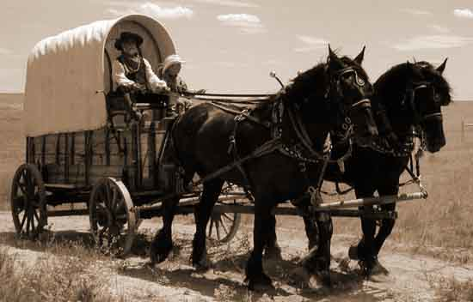
Outcome: Westward Expansion
Reconstruction and Westward Expansion

Slide 2
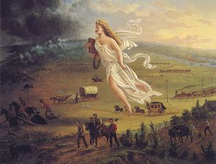
Westward Expansion
Setting the Stage (Background on the West)
Americans believed in the idea of Manifest Destiny, the idea that it was their God given right to expand westward to the Pacific Ocean and to Mexico

Slide 3
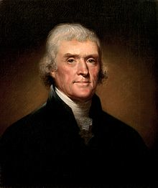
Thomas Jefferson & napoleon

Slide 4
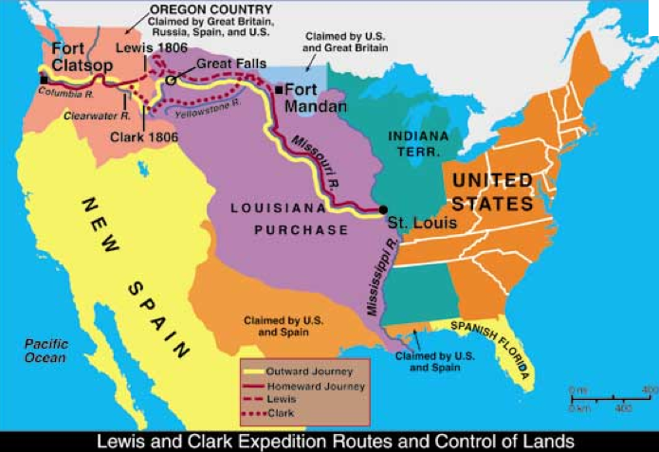
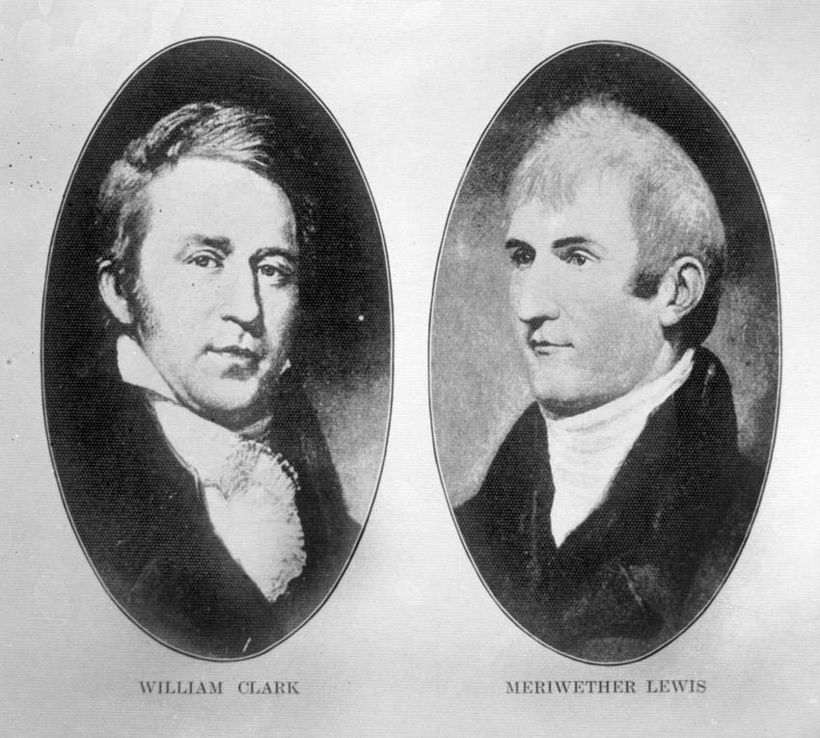
Westward Expansion
President Thomas Jefferson bought the Louisiana Purchase from Napoleon Bonaparte of France in 1803 for $15 million
Between 1804 to 1806, explorers Lewis and Clark were commissioned by President Jefferson to explore west to the Pacific coast

Slide 5
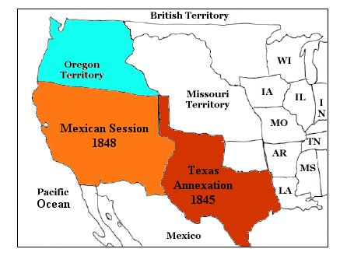
Westward Expansion
The US annexed Texas in 1845 which led to the Mexican-American war which took place between 1846-1848 and resulted in US obtaining the present day southwest United States territory from Mexico
The Oregon Treaty of 1846 with Britain resulted in the US obtaining Oregon, Washington state, and parts of Wyoming, Montana, and Idaho

Slide 6
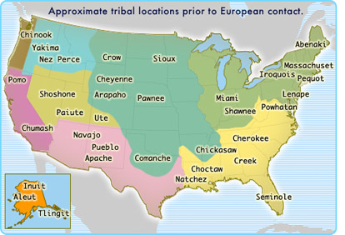
Westward Expansion
The United States now stretched from the Atlantic to the Pacific, however, many Native American tribes lived on these newly obtained pieces of land and had called this land home for hundreds of years

Slide 7
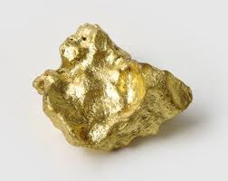
Westward Expansion
Motivations to settle the West
The California gold rush of 1849 & the discovery of gold in Colorado in 1858 sparked a wave of settlers to the west hoping to literally strike gold
Mining towns were filthy and included fortune seekers of every kind including Irish, German, Polish, Chinese, and African Americans
Free land! The Homestead Act of 1862 offered 160 acres to citizens; 600,000 families took advantage of this offer

Slide 8
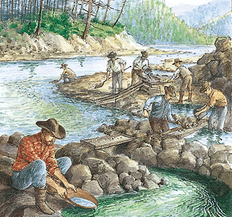
California gold rush

Slide 9
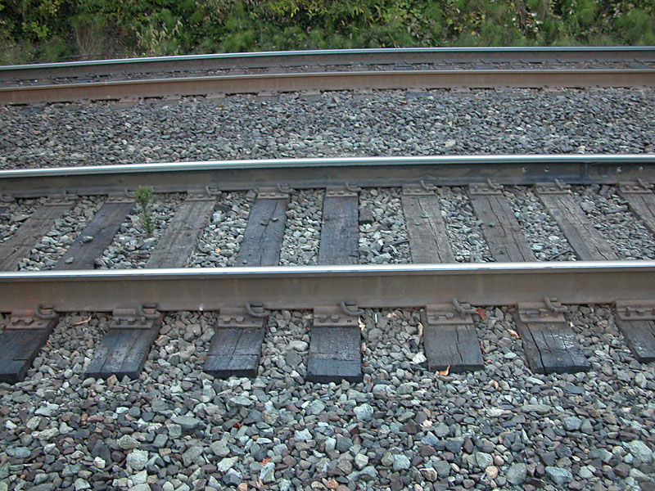
Westward Expansion
The Transcontinental Railroad
The federal government offered 170 million acres in land grants to railroads between 1850-1871
Land grants were pieces of land given by the federal government to encourage railroad companies to build more railroads westward

Slide 10
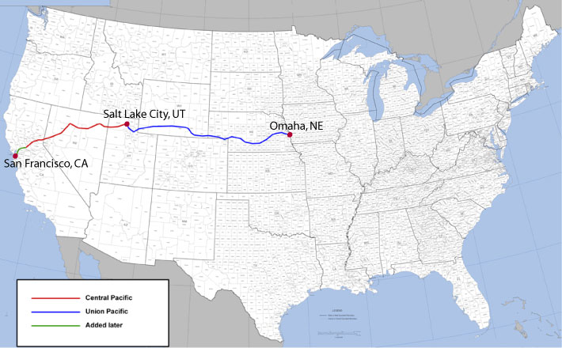
Westward Expansion
The Central Pacific moved eastward from Sacramento
The Union Pacific moved westward from Omaha, Nebraska

Slide 11
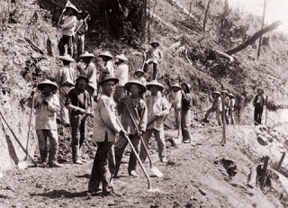
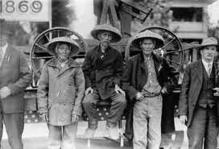
Westward Expansion
Both companies relied heavily on foreign labor such as Irish and mostly Chinese workers

Slide 12
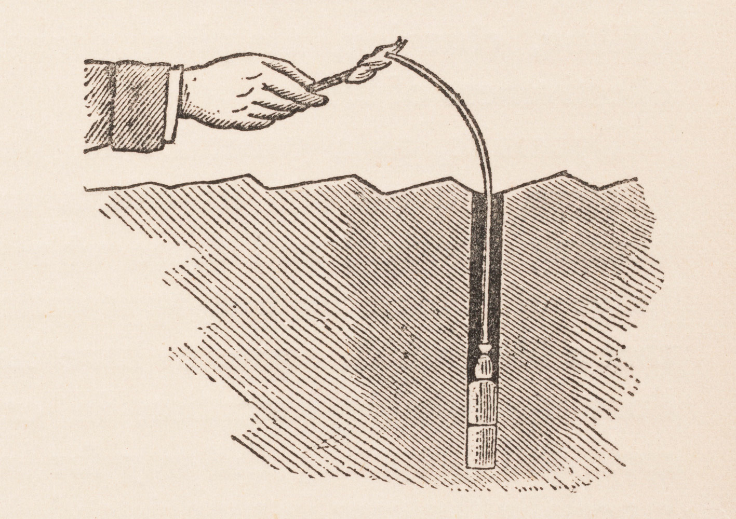
Westward Expansion
The Central Pacific used unstable nitroglycerin to blast through the difficult terrain of the Sierra Nevada mountains
Both companies reached Promontory Point, Utah by 1869 where a golden spike was driven to hail the completion of the railroad
Fifteen years later, the US had five transcontinental railroads
The railroads significantly shrunk the size of the US and allowed for settlers to migrate west more quickly and efficiently

Slide 13
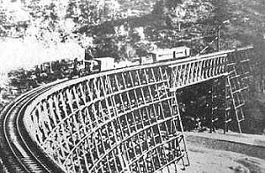
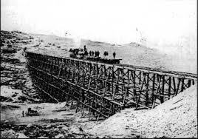
Transcontinental Railroad bridges

Slide 14
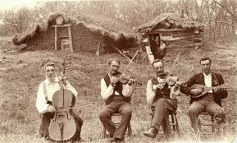
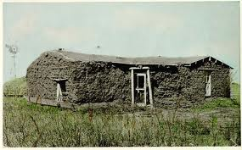
Westward Expansion
Life in the West
Trees were often scarce so settlers built their homes called sod homes, or soddies, from the land itself

Slide 15
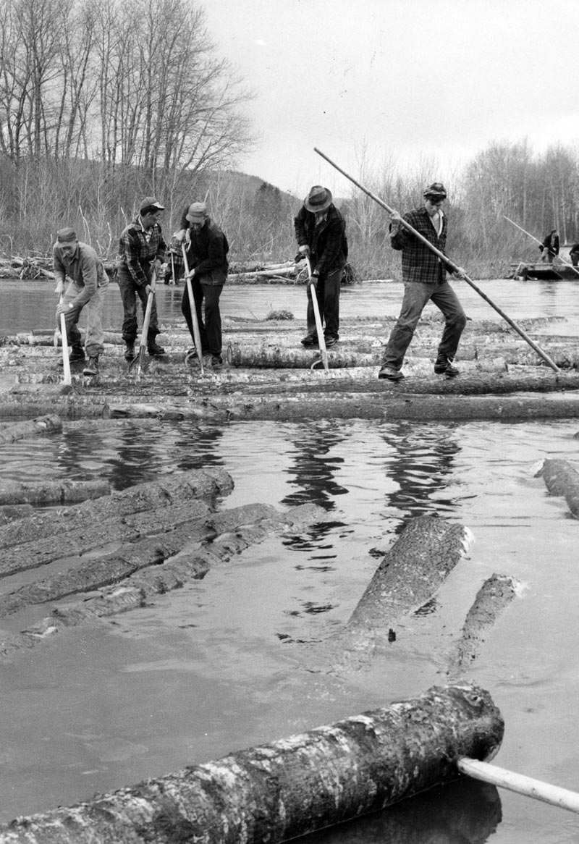
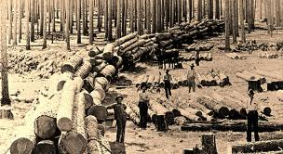
Westward Expansion
Life in the West
Women often worked in the fields with men plowing, planting, and harvesting the crops
Minnesota and Wisconsin were important for lumber production

Slide 16
Westward Expansion
Life in the West
Frontier settlers faced many hardships such as droughts, floods, fires, blizzards, locust plagues, and occasional raids by outlaws and Native Americans

Slide 17
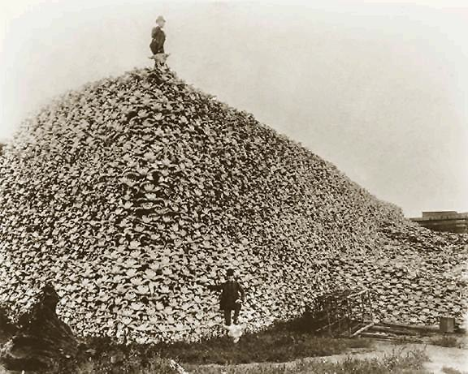
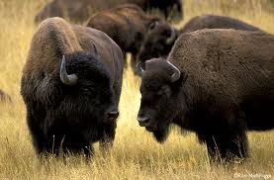
Westward Expansion
Result: Even though America was now a complete nation, conflict with Native Americans would be the next real challenge & would remind us that there is a consequence to progress.

