Slide 1
French Absolutism, Enlightenment, & Revolution!
Outcome: The Enlightenment

Slide 2
Constructive Response Questions
What was the Enlightenment and who were some of the key contributors?

Slide 3
What Will We Learn?
What is the Enlightenment
Thomas Hobbes
John Locke
The Philosophes

Slide 4
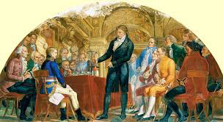
The Scientific Revolution
Setting the Stage: The Renaissance & The Reformation
The Renaissance, a rebirth of learning and the arts, inspired a spirit of curiosity in many fields.
Scholars began to question ideas that had been accepted for hundreds of years
The Reformation prompted religious followers to challenge accepted ways of thinking about God and salvation.

Slide 5
The Enlightenment
The Enlightenment
Not only did new ways of thinking apply to science, but were also applied to all aspects of society: government, religion, economics, and education.
This spurred on the Enlightenment: a new intellectual movement that stressed reason and thought and the power for individuals to solve problems.

Slide 8
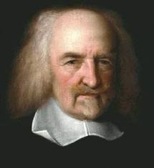
Thomas Hobbes

Slide 9
The Enlightenment
Views on Government: Thomas Hobbes
All humans are naturally selfish and wicked and we a strong ruler to govern.
Hobbes called for a social contract, a government where people agreed to give total control to a monarch because people acted in their own self interest.

Slide 10
John Locke

Slide 11
The Enlightenment
Views on Government: John Locke
More positive view than Hobbes; people could learn from experiences and improve themselves
All people are born free and equal with three natural rights: life, liberty, and property.
The purpose of government is to protect these rights, if they fail to do so, the citizens have the right to over throw it.

Slide 12
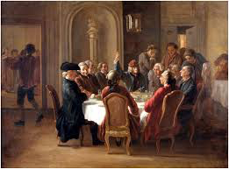
The Enlightenment
The Philosophes Advocate Reason
Social critics in France during the 1700s were known as philosophes
Five concepts formed their core beliefs: Reason, Nature, Happiness, Progress, Liberty

Slide 13
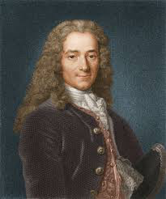
The Enlightenment
The Philosophes Advocate Reason
Voltaire was the most brilliant and influential of the philosophes
He used satire against the clergy, aristocracy, and government
Even though Voltaire made enemies, he never stopped fighting for tolerance, reason, freedom of religion and freedom of speech.

Slide 14
The Enlightenment
The Philosophes Advocate Reason
Montesquieu believed Britain was best-governed and helped influence creation of US government
Rousseau was passionately committed to individual freedoms
Beccaria was interested in the justice system; laws existed to preserve social order, not to avenge crimes.
Mary Wollstonecraft argued that women’s education should not be secondary to men’s and that women need to education to become more virtuous and useful.

Slide 15
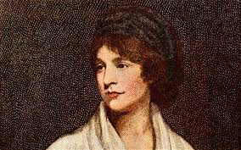
Mary Wollstonecraft

Slide 16
The Enlightenment
Result: The Enlightenment writers challenged long held beliefs and ideas about society. They challenged the church, state, monarchs, and unequal social classes. These ideas would spread and ultimately help start two of the most influential events of World History: The American and French Revolutions.

Slide 17
Constructive Response Questions
What was the Enlightenment and who were some of the key contributors?

