Slide 1
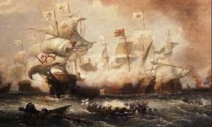
The Age of Exploration
Outcome: The Spanish Empire Weakens

Slide 2
Constructive Response Questions
Describe Spain’s motivation for exploration and how Spain’s economy fell apart:

Slide 3
What Will We Learn?
Charles V
Philip II of Spain
The Spanish Armada
4 Reasons Spanish Empire weakens

Slide 4
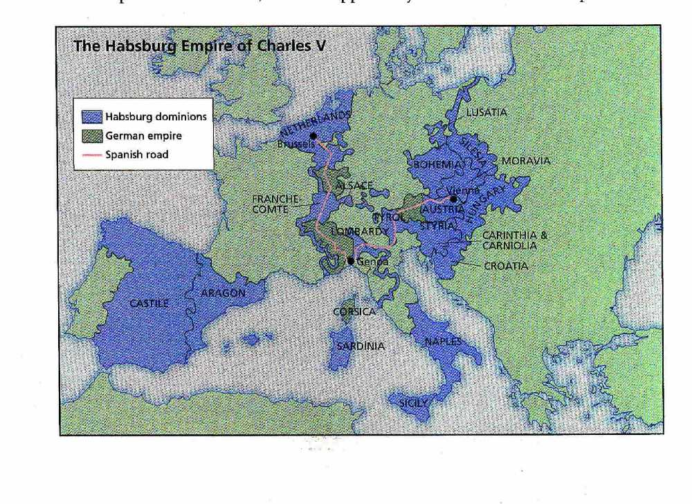
The Age of Exploration

Slide 5
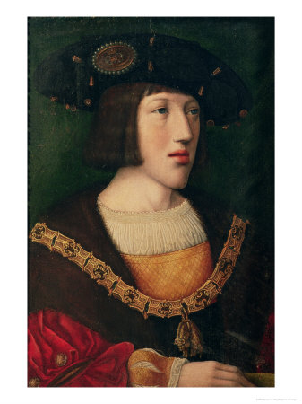
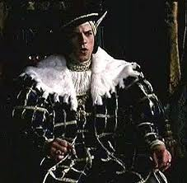
Charles V

Slide 6
The Spanish Empire Weakens
Setting the Stage: Charles V
Habsburg King, Charles V, inherited Spain, Spain’s American colonies, parts of Italy, lands in Austria and the Netherlands.
Was elected Holy Roman Emperor and ruled much of Germany as well
Devout Catholic who sparred with Martin Luther but eventually signed the Peace of Augsburg which allowed Protestants to have their beliefs
Following Peace of Augsburg, he divided up his territory and retired to a monastery
Brother Ferdinand got Austria and the Holy Roman Empire
Son Philip II inherited Spain, Spanish Netherlands, and American colonies

Slide 7
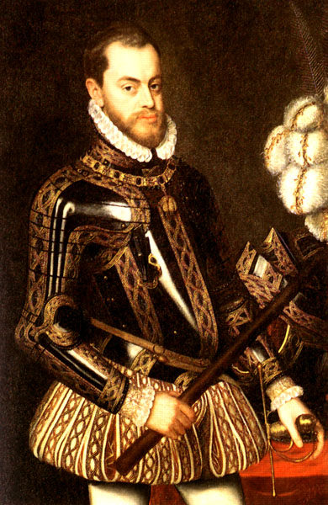
Philip II

Slide 8
The Spanish Empire Weakens
A Powerful Spanish Empire
Philip II
Deeply religious (Catholic) and hard working
Was very suspicious of most people and did not trust for long
When Portuguese king died without an heir, Philip seized the kingdom for Spain which included strongholds in Africa, India, and the East Indies
Spain’s land brought in tons of wealth: mercantilism --> wealth = power

Slide 9
The Spanish Empire Weakens
PHILIP II CONTINUED…
Each shipload of treasure brought in was required to give king between ¼ and 1/5 of cargo which allowed Spain to have army of over 50,000 soldiers
Philip was a defender of Catholicism
Created the Spanish Armada in 1588
Huge Catholic fleet of Spanish ships
Plan was to punish Protestant England under Queen Elizabeth I
Fleet was defeated by English tactics and by weather
Result: Spain was seriously weakened by defeat of Spanish Armada but still had great wealth that would give Spain strength for a short while longer.

Slide 10
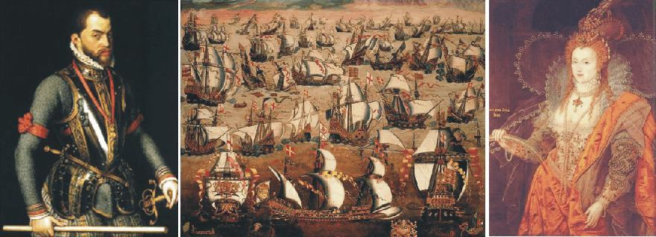
Philip II’s Spain vs. Elizabeth I’s England

Slide 11
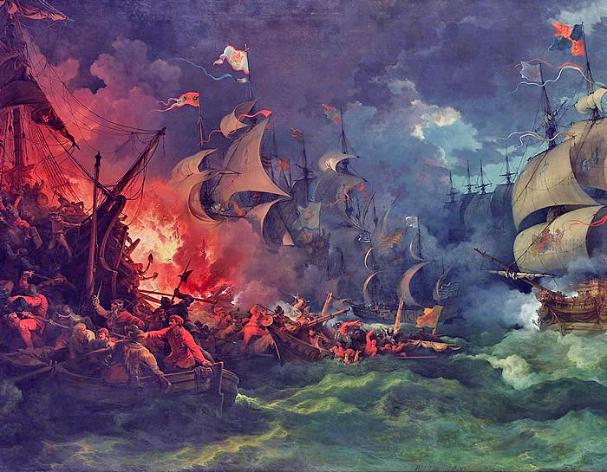

Slide 12
The Spanish Empire Weakens
The Spanish Empire Weakens
Spain’s empire would fall apart for 4 main reasons:
Inflation: decline in value of money
Caused by a rise in population, thus, a rise in demand for goods allowed merchants to raise prices.
Taxes:
Spain had expelled the Jews and Moors who were valuable artisans and business people (less collected in taxes)
Spain’s nobles didn’t have to pay taxes
Tax burden fell to lower classes, which meant they stayed poor.
Result: Spain never developed a middle class.

Slide 13
The Spanish Empire Weakens
Poor spending choices
Spanish cloth and manufactured goods were more expensive than those made elsewhere
Spaniards purchased goods from France, England, Netherlands
To pay for wars, Spanish kings borrowed from German and Italian bankers
Result: Spanish wealth was not re-circulated within Spain, which allowed Spain’s neighbors to prosper. Most gold and silver that came in was shipped off to Germany and Italy to repay debts. Spain’s economy is crumbling.

Slide 14
The Spanish Empire Weakens
Dutch Revolt
The Dutch revolt in Spanish controlled Netherlands
Dutch were Calvinists (Protestants) and Spain was Catholic
Philip raised taxes and sent troops in. Executed 1500 Protestants.
Dutch and Spanish fight for another 11 years and in 1579 the Dutch declared their independence

Slide 15
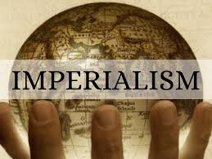
The Spanish Empire Weakens
Result: At the end of the Age of Exploration, the Spanish Empire was no longer leading the way, however with their downfall, countries like Great Britain would be able to rise up and become the world’s imperialistic leader.

Slide 16
Constructive Response Questions
Describe Spain’s motivation for exploration and how Spain’s economy fell apart:

