Slide 1
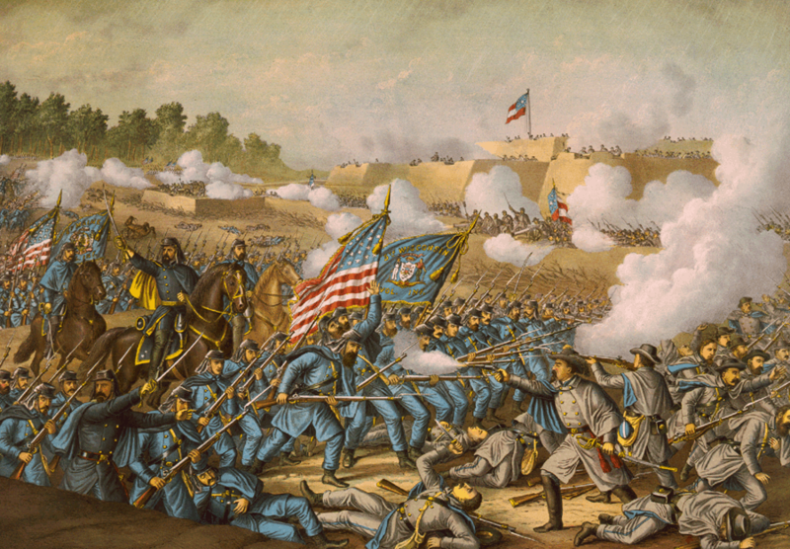
Reconstruction & Westward Expansion
Outcome: Reconstruction

Slide 2
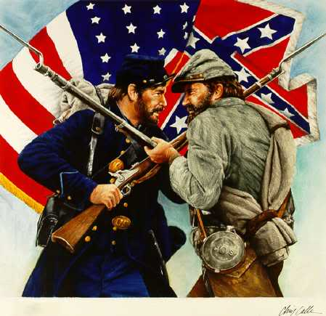
The Civil War

Slide 3
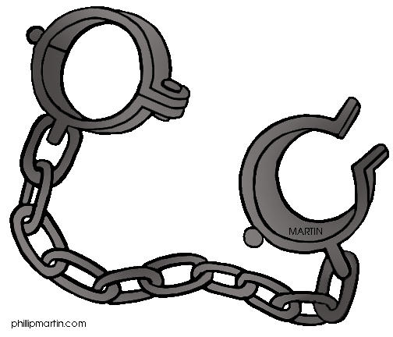
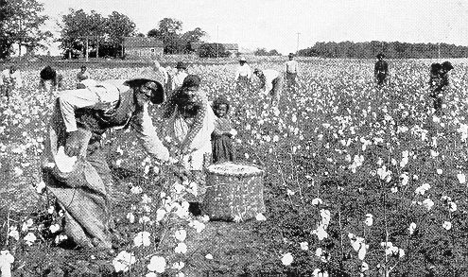
The Civil War
Setting the Stage: The Civil War Revisited
Causes: The American Civil War was caused by a complex combination of issues surrounding slavery
Morally: Many Northerners were against idea of slavery
Economically: Many Southerners were completely dependent on slavery

Slide 4
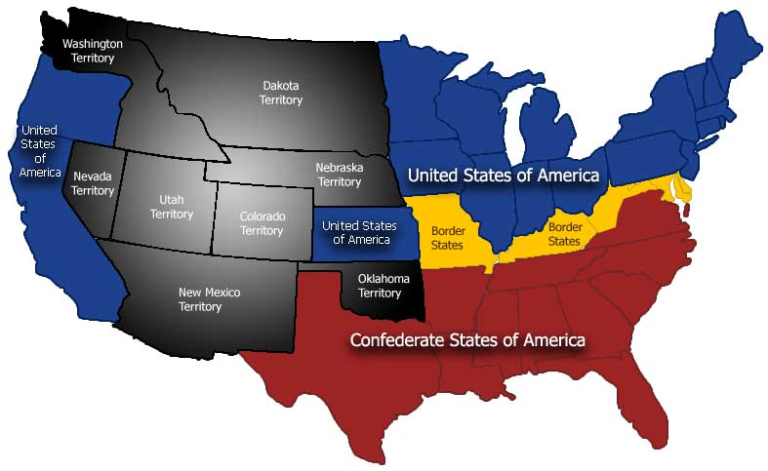
The Civil War

Slide 5
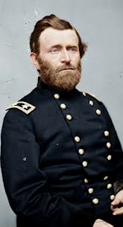
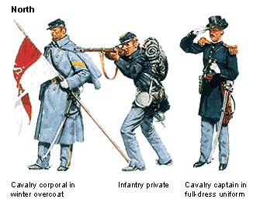
The Civil War
The North (The Union)
Led by Ulysses S. Grant (Eventually elected president in 1868)
Advantages: more factories, more food production, larger troop numbers, more railroads, better navy, & Abraham Lincoln

Slide 6
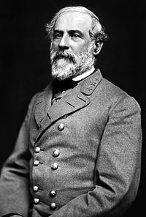
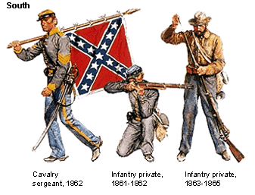
The Civil War
The South
Led by General Robert E. Lee
Advantages: better military leadership, naturally skilled soldiers, home-field advantage, motivated troops

Slide 7
The Civil War
How did it end?
Northern numbers and centralized war effort was too much for the Southern military to overcome
Lee surrenders to Grant at Appomattox Courthouse on April 9, 1865
Lincoln was shot by John Wilkes Booth at Ford’s Theater on April 14, 1865 and died the next morning
Andrew Johnson was sworn in as president

Slide 8
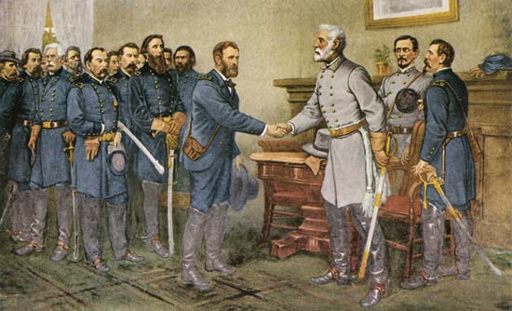
Surrender at Appomattox Courthouse

Slide 9
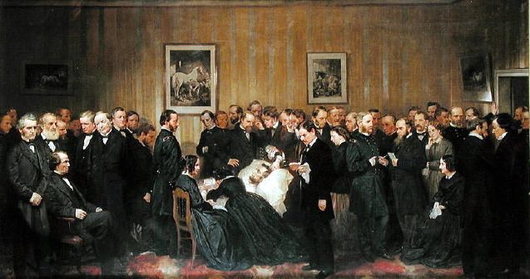
Death of Lincoln

Slide 10
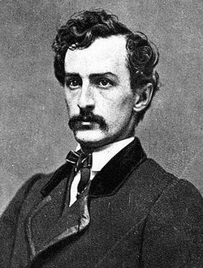
John Wilkes Booth

Slide 11
Reconstruction
What is Reconstruction?
Reconstruction is the period during which the United States began to rebuild after the Civil War roughly 1865-1877
Essentially, reconstruction was the attempt to readmit the Confederate states back into the Union
Lincoln, Andrew Johnson, and Congress all had different ideas about how Reconstruction should be handled
Confederate readmission into Congress took place between 1866-1870
President Johnson removed Secretary of War Edwin Stanton from office and was impeached for violating the Tenure of Office Act but remained in office after the Senate voted not to convict
Impeachment: the process of accusing a public official of wrongdoing

Slide 12
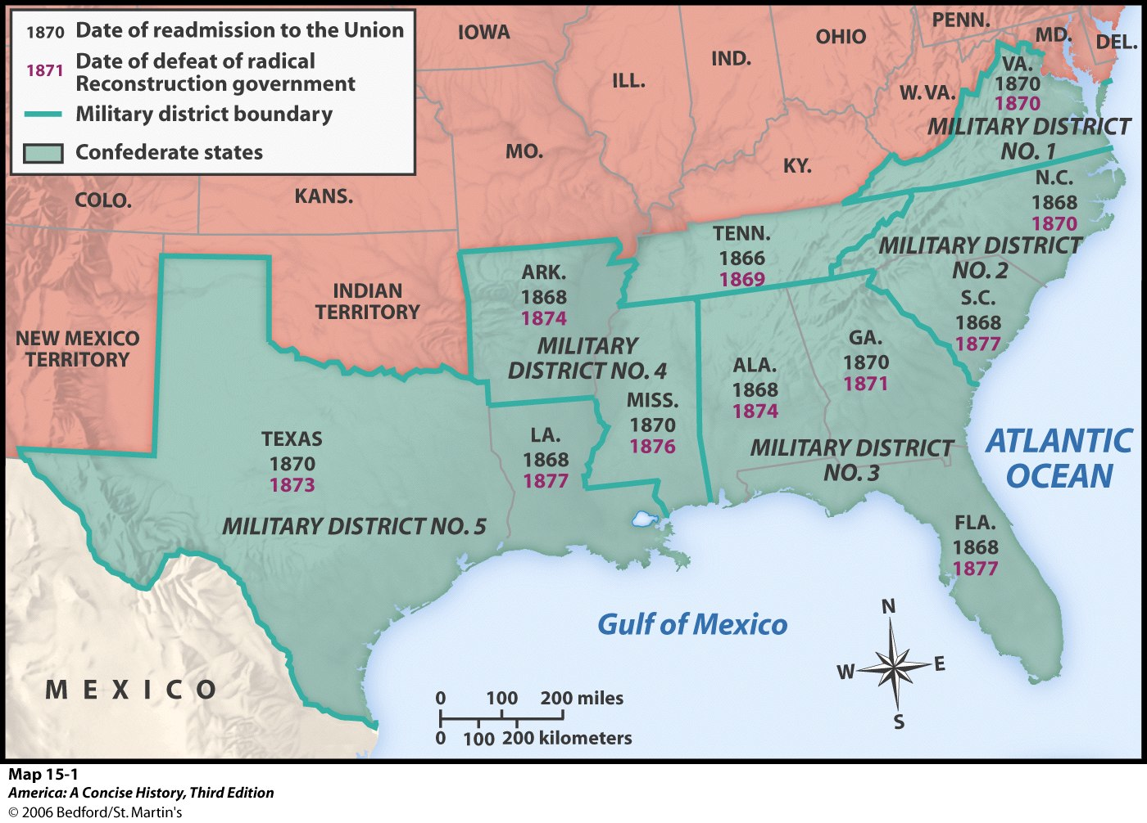

Slide 13
Reconstruction
What changes were enacted
The Reconstruction Amendments
13th: Prohibition of Slavery
14th: States cannot deprive citizens of life, liberty, or property without “due process” & States must provide “equal protection” to all citizens under the law
15th: Cannot deny right to vote based on race

Slide 14
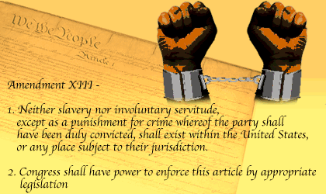
13th Amendment

Slide 15
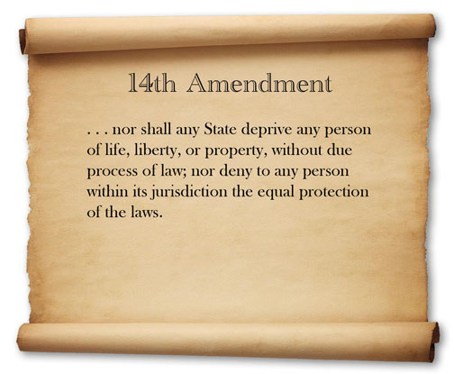
14th Amendment

Slide 16
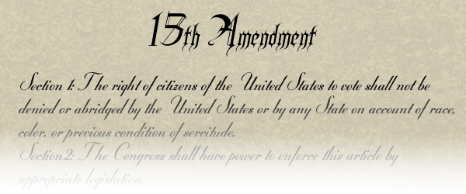
15th Amendment

Slide 17
Reconstruction
The Reconstruction Acts tried to prevent states from discriminating against Blacks
The Enforcement Acts allowed the Federal Government to intervene when states refused to follow these laws
The Civil Rights Act of 1875 prohibited discrimination in public services like hotels, public transportation, and restaurants
***If the laws are followed and enforced, as listed above, discrimination based on race is illegal***

Slide 18
Reconstruction
Result: The Civil War changed America. The country was ripped apart due to the idea of slavery only to be carefully reconstructed to bring unity back. Reconstruction brought with it many new freedoms for those who had previously been denied freedom and rights. As you will see coming up, that freedom and those rights would be relatively short lived.

