Slide 1
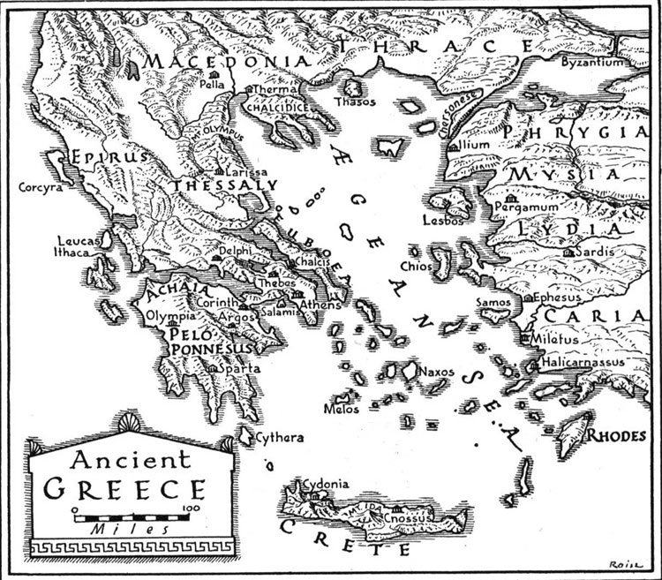
Classical Greece
Outcome: Geography & Early Culture

Slide 2
Constructive Response Question
In what ways did the geography of Greece help shape Greek culture?

Slide 3
What are we going to learn?
Greek Geography
Early cultures that influenced Greece (Minoans, Mycenaeans, Phoenicans, and Dorians)
Early Greek Culture

Slide 4
Geography & Early Culture
Setting the Stage:
The geography of the ancient Greeks was considerably different than the previous cultures we have studied.
The culture of the ancient Greeks was shaped by several different cultures: The Minoans, the Mycenaeans, the Phoenicians, and the Dorians.

Slide 5
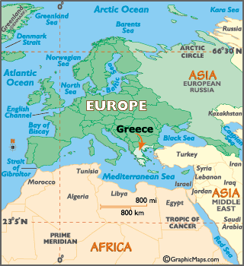
Where is Greece?

Slide 6
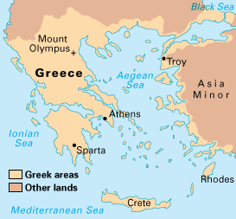
Ancient Greece

Slide 7
Geography & Early Culture
Geography Shapes Greek Life
Ancient Greece most consisted of a mountainous peninsula jutting out into the Mediterranean Sea
Over 2,000 Islands in the Aegean and Ionian Seas
The sea was to Greece what rivers were to Egypt and Mesopotamia
It was said that the Greeks did not live on the land but around the sea
The Greeks became master ship builders due to sea trade

Slide 8
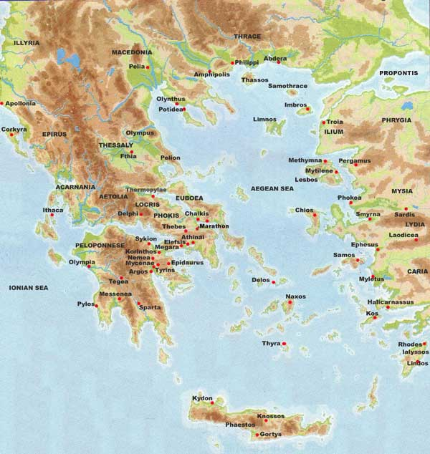
Physical Map

Slide 9
Geography & Early Culture
Greece lacked natural resources such as farmland, timber, and precious metals
Rugged mountains covered 3/4ths of ancient Greece.
The mountains divided up Greece into several different territories and shaped Greek political life
Uneven terrain made travel difficult
Large scale irrigation was not possible
Land could not sustain a large population
Climate varied from 48 degrees F in winter to 80 degrees F in summer

Slide 10
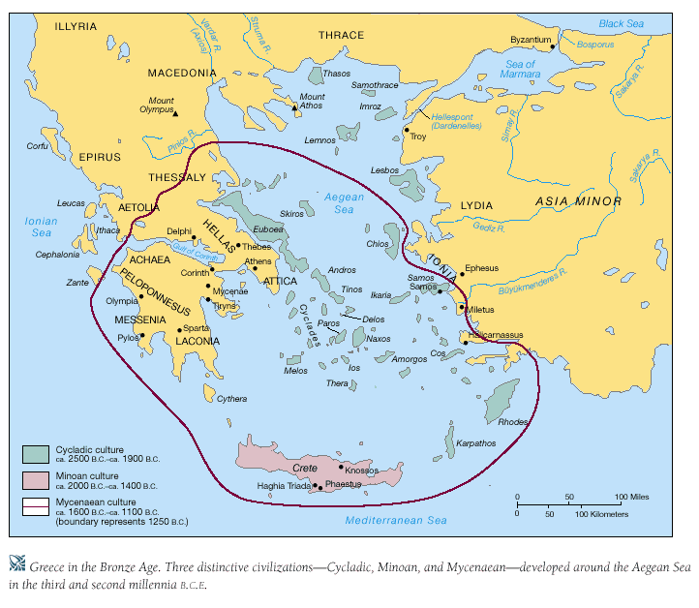
The Minoans

Slide 11
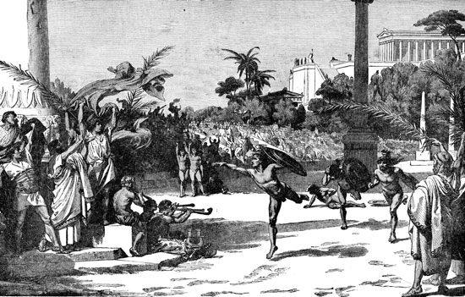
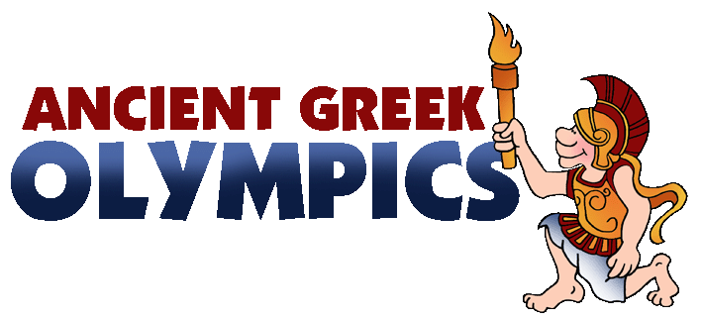
Geography & Early Culture
Early Cultures Influence the Greeks
The Minoans
Gave the Greeks architecture, burial customs, and religious rituals
Were outdoorsy and athletic like the Greeks

Slide 12
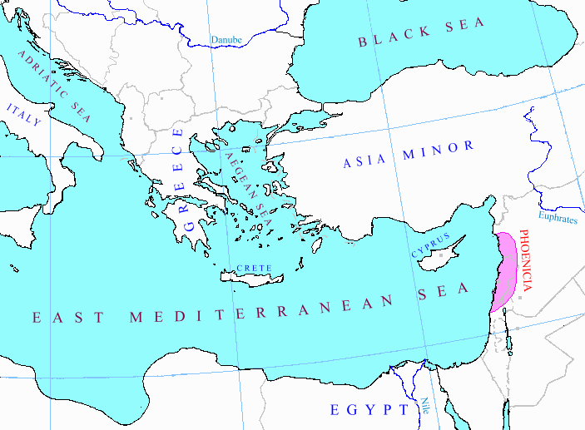
The Phoenicians

Slide 13
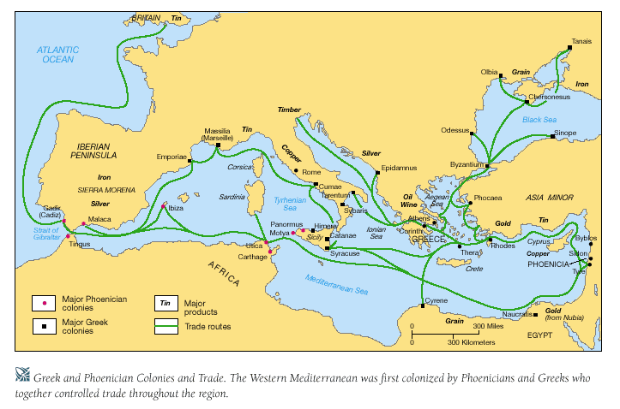
Geography & Early Culture
The Phoenicians
Gave the world the Phonetic Alphabet
Were excellent merchant ship builders – influenced Greek ship building

Slide 14
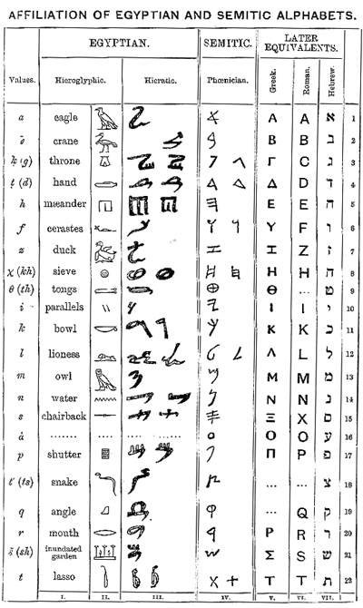

Slide 15
The Mycenaeans

Slide 16
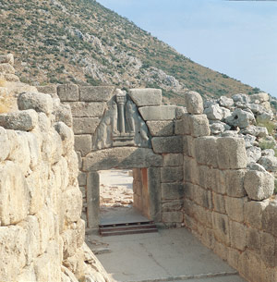
Geography & Early Culture
The Mycenaeans
Influenced Greek religious practice, art, politics, and literature
Fought the Trojans at Troy in the Trojan Wars

Slide 17
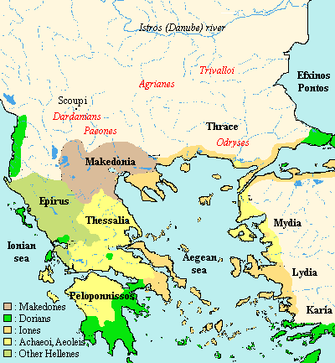
The Dorians

Slide 18
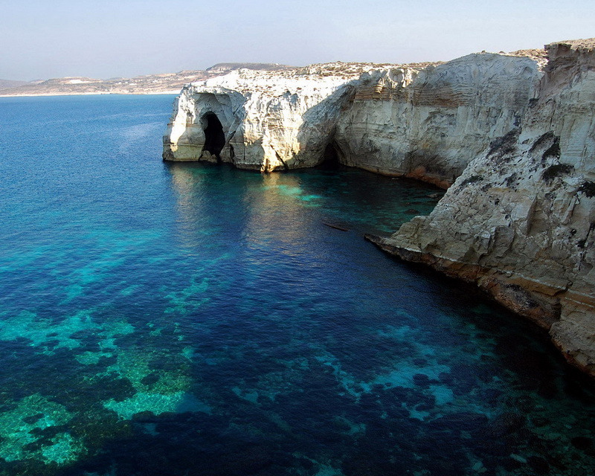
Geography & Early Culture
The Dorians
Took over after the Mycenaeans
Not much is known about the Dorians
Known as dark ages of Greek History

Slide 19
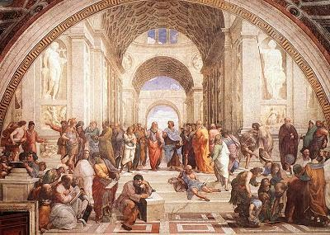
Geography & Early Culture
Greek Culture
Due to the warm climate, the Greeks enjoyed and participated in outdoor activities
Due to terrain, the Greeks created city-states
Review: city-states operate much like independent countries
Due to city-states, the Greeks were a civilization but not an empire
The Greeks shared similarities in culture but politics and military differed by city

Slide 20
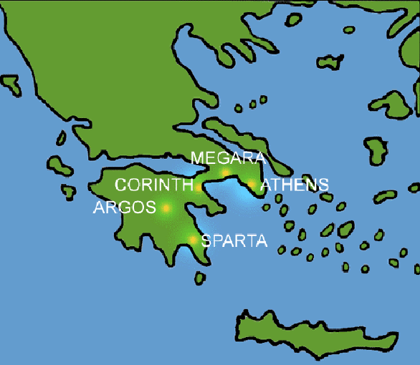
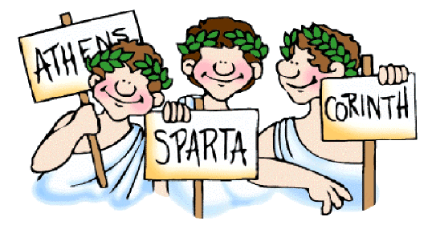
Greek City-States

Slide 21
Geography & Early Culture
Greek epics, or narrative poems, celebrated heroic deeds and characters
Homer wrote the Iliad (story of the Trojan Wars) and the Odyssey

Slide 22
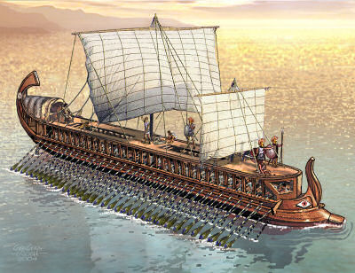
Geography & Early Culture
Due to the sea the Greeks were master ship builders
Built Triremes: sturdy ships with battering ram in front for battle

Slide 23
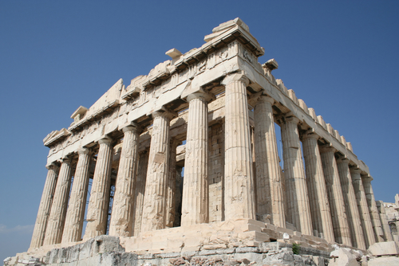
Greek Architecture
Where do you see similar structures today??

Slide 24
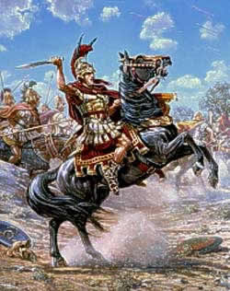
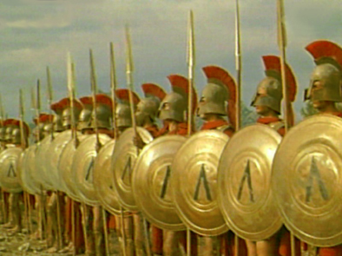
Geography & Early Culture
Greeks would pioneer democracy, philosophy, warfare, and architecture
Greeks would fight many battles against the superpower at the time: The Persians
Alexander the Great would blend Greek, Persian, & Egyptian culture as he conquered much of SW Asia

Slide 25
What are we going to learn?
Greek Geography
Early cultures that influenced Greece (Minoans, Mycenaeans, Phoenicans, and Dorians)
Early Greek Culture

