Slide 1
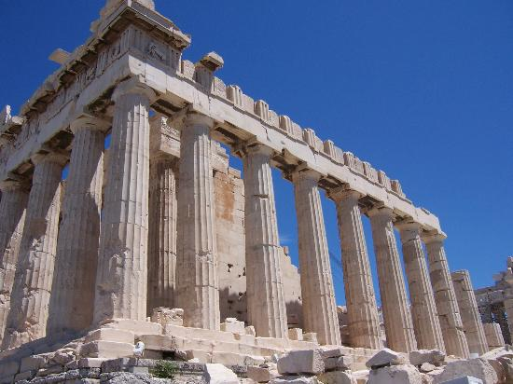
Classical Greece
Outcome:
The Athenian Golden Age

Slide 2
Constructive Response Question
What was the Athenian Golden Age?

Slide 3
What will we learn?
Athens and Sparta
The Peloponnesian War
Philosophers (Socrates, Plato, Aristotle)

Slide 4
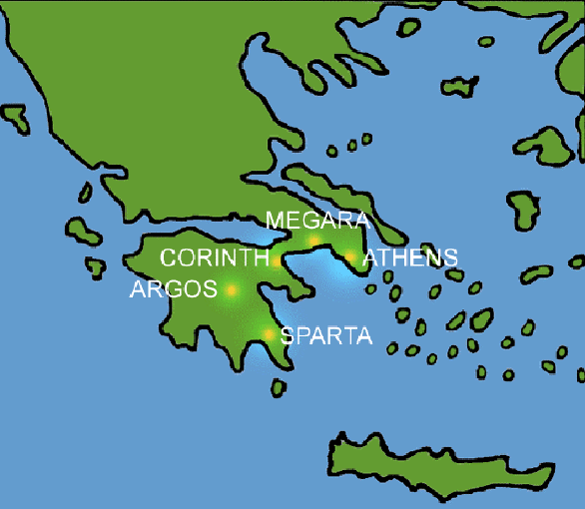
The Athenian Golden Age
Setting the Stage
The Greek Civilization was a collection of city-states
Athens and Sparta were two of the most powerful cities for different reasons

Slide 5
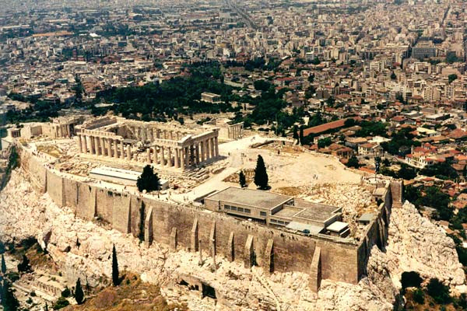
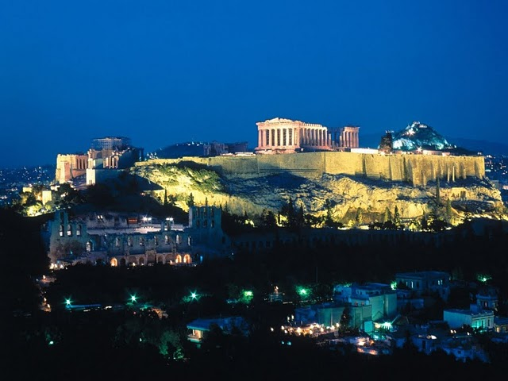
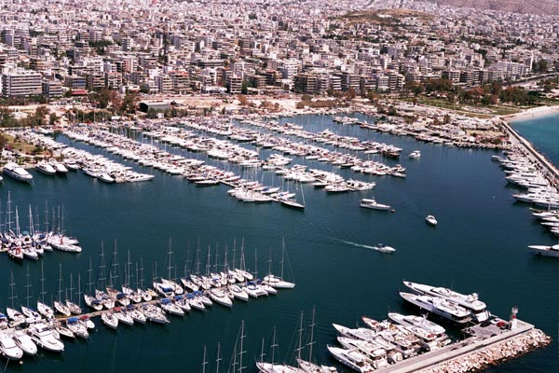
Athens Today

Slide 6
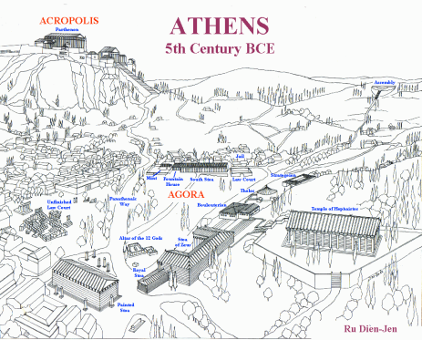
Ancient Athens

Slide 7
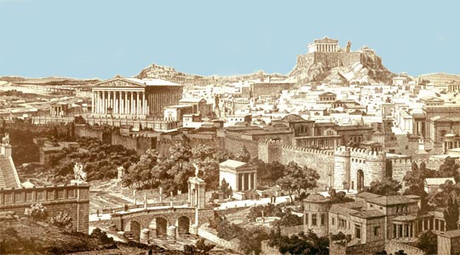
Ancient Athens

Slide 8
The Athenian Golden Age
Athens
From 477 to 431 B.C., Athens experienced a growth in intellectual and artistic learning. This was known as the Golden Age of Athens.
Pericles: held power in Athens for 32 years
Goals:
Strengthen Athenian Democracy
To hold and strengthen the empire
Glorify Athens-
Architecture: The Parthenon on the Athenian Acropolis
Direct Democracy was introduced under Pericles
Head of Delian League, an alliance system created after the defeat of the Persians

Slide 9
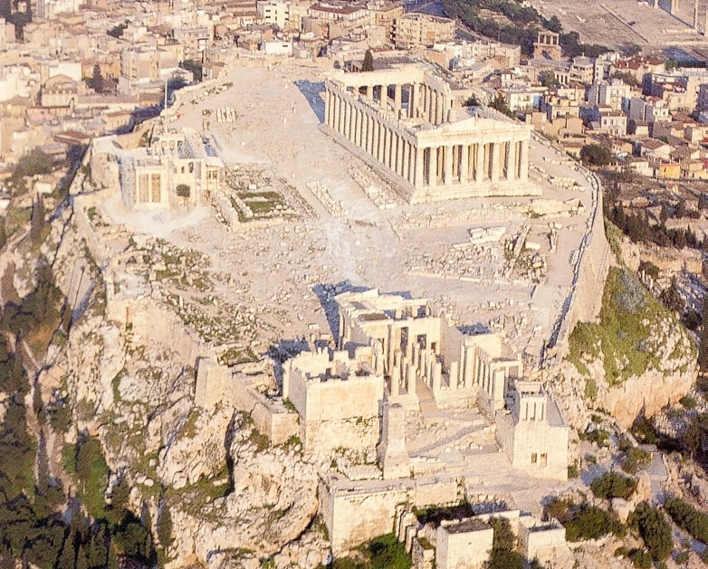
Athenian Acropolis

Slide 10
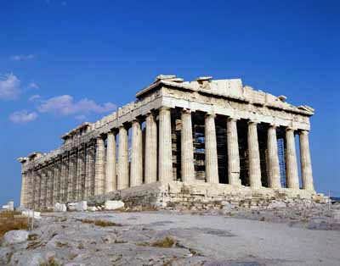
The Parthenon

Slide 11
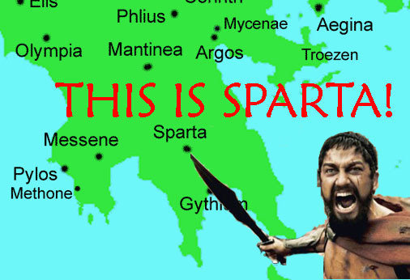
Sparta

Slide 12
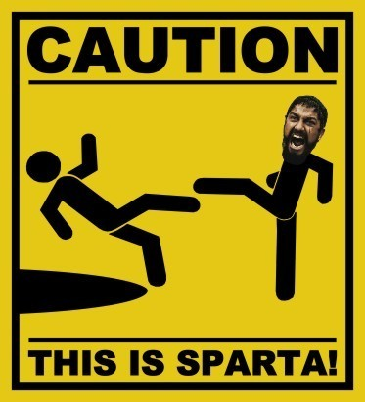

Slide 14
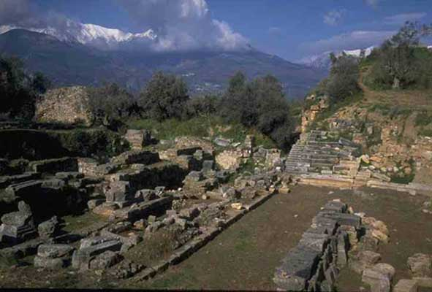
The Athenian Golden Age
Sparta
Sparta was a military city-state
Sparta had a better army than Athens; Athens had the better navy
Weren’t Builders
Due to its inland location, Sparta could not be attacked by sea
Many men in Sparta were soldiers for life

Slide 15
The Athenian Golden Age
Peloponnesian War: Athens vs. Sparta
As Athens grew, city-states viewed it with hostility
Sparta declared war in 431 B.C.
Sparta marched to Athens and burned food supply
Plague hits Athens in 2nd year of the war- 1/3rd die including Pericles
421 B.C. a truce is signed but doesn’t last long
In 413 B.C Athens’ navy is decimated at Syracuse (Spartan ally)
Athens survives for 9 more years but surrenders to Sparta in 404 B.C.

Slide 16
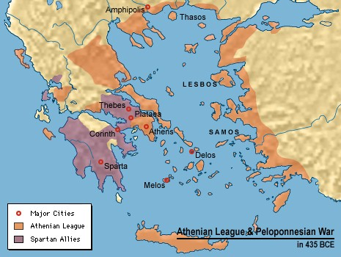
Peloponnesian War

Slide 17
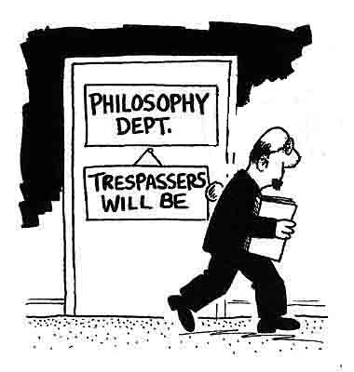
The Athenian Golden Age
Philosophers
After the Peloponnesian War, many Athenians lost confidence in democracy
Great thinkers known as philosophers began to seek truth
Philosophers (lovers of wisdom) had two assumptions
The universe is put together in an orderly way, and subject to absolute and unchanging laws
People can understand these laws through logic and reason

Slide 18
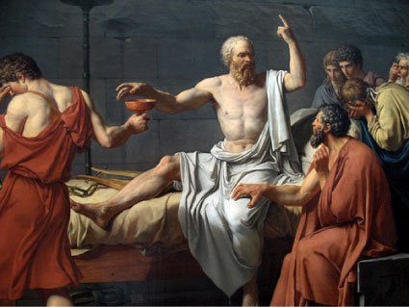
The Athenian Golden Age
Important philosophers
Socrates
“The unexamined life is not worth living”
In 399 B.C. brought to trial for “corrupting the youth of Athens”
Jury condemned him to die: drank hemlock (poison)

Slide 19
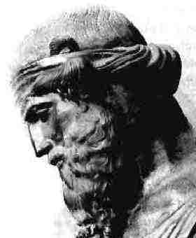
The Athenian Golden Age
Plato
Student of Socrates
Wrote “The Republic” –perfectly governed society
Pupil- Aristotle

Slide 20
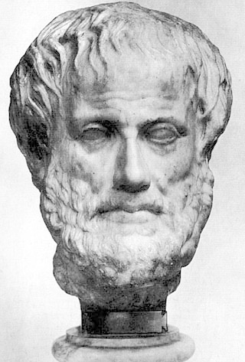
The Athenian Golden Age
Aristotle
Questioned the nature of the world
Invented method of arguing according to rules of logic
His work provides basis of the scientific method today
Pupil- Alexander the Great

Slide 21
Constructive Response Question
What was the Athenian Golden Age?

