Slide 1
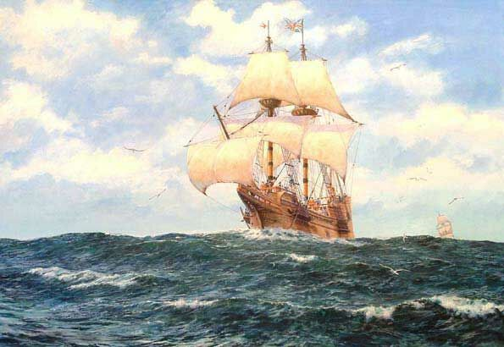
The Age of Exploration
Outcome: Europeans Explore the East

Slide 2
Constructive Response Questions
What innovations allowed Europeans to travel farther?

Slide 3
What Will We Learn?
New innovations in sailing
Portugal leads the way
Spain joins in
The Dutch also join in

Slide 4
The Age of Exploration
Setting the Stage
Europeans had been exploring via the Crusades and with people like Marco Polo
For the most part, Europeans had no interest or ability to explore foreign lands
By 1400s, a desire for wealth coupled with advanced sailing techniques sparked exploration.

Slide 5
The Age of Exploration
Europeans Seek New Trade Routes
Main desire for exploration: New sources of wealth (spices & luxury goods from Asia)
Demand was higher than supply meant merchants could charge higher prices
England, Spain, Portugal, and France wanted to bypass Italian merchants and find new sea routes for themselves
Europeans also used Christianity as a means to travel: They wanted to convert non-Christians throughout the world

Slide 6
The Age of Exploration
Tools of Exploration
European ships improved with technology (p.531)
New vessel: The caravel.
Sturdier
Triangular sails stronger against the wind
Large cargo area
Shallow draft allowed it to explore close to the shore
Sextant was an instrument used to determine latitude and longitude

Slide 7
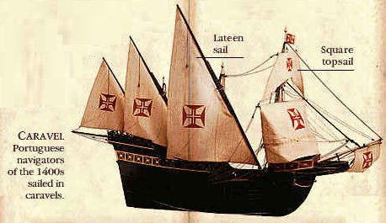
New Weapons Technology

Slide 8
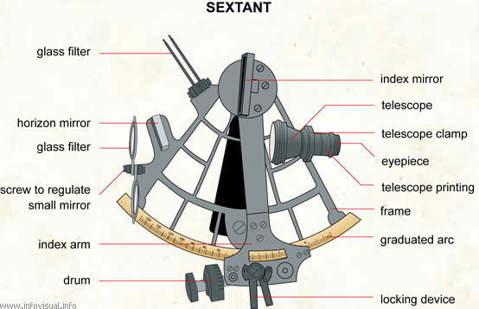

Slide 9
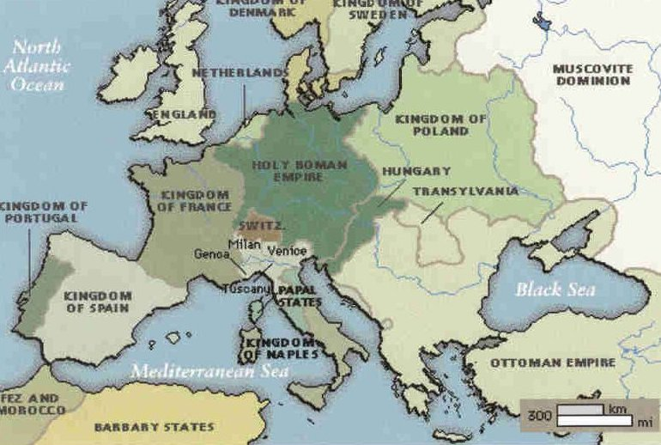
Portugal

Slide 10
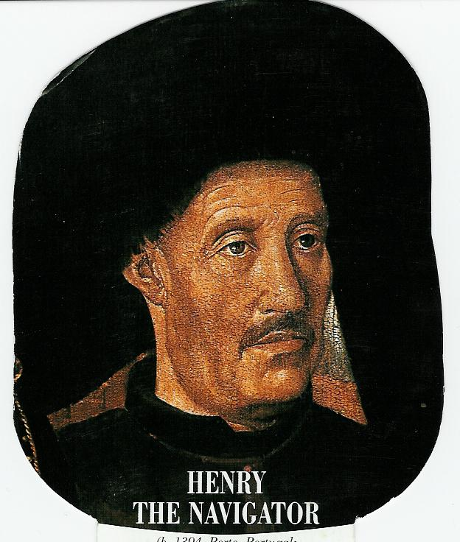
Prince Henry, the Navigator
School for Navigation, 1419

Slide 11
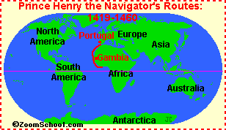
The Age of Exploration
Portugal Leads the Way
Portugal led the way in sailing innovations
First country to establish trading outposts on west coast of Africa
Prince Henry, son of the king, was Portugal’s most enthusiastic exploration explorer
Prince Henry wanted to reach treasures of the east and spread Christianity

Slide 12
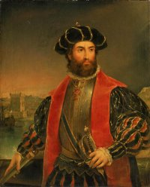
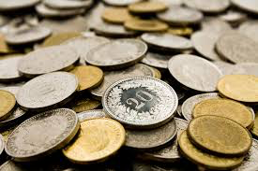
The Age of Exploration
Portugal Leads the Way
Vasco da Gama sailed to the eastern side of Africa and reached SW India
da Gama and crew were astonished by spices, silks, and gems found in India
da Gama’s remarkable 27,000 mile journey was worth 60 times the cost of the trip and provided Portugal with a direct sea route to India

Slide 13
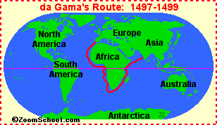
Vasco da Gama’s Route

Slide 14
Spain

Slide 15
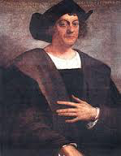
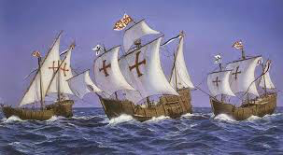
The Age of Exploration
Spain Also Makes Claims
Spain watched Portugal with envy
1492 Christopher Columbus convinces Spain to finance a bold plan of finding a sea route to Asia ---> Instead he is the first European to discover Americas
Portuguese suspected Columbus reached Asia and claimed land for Spain that Portugal had already claimed.
This increased the exploration rivalry between Spain and Portugal
The pope steps in and attempts to settle who has claim ---->

Slide 16
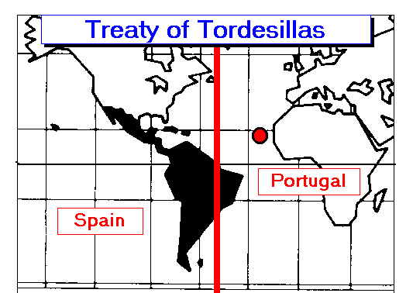
The result: The Treaty of Tordesilla of 1494: Line that divided Spain and Portugal’s claims. Spain got land west of the line, which included most of the Americas, Portugal got lands to the east which included parts of modern-day Brazil

Slide 17
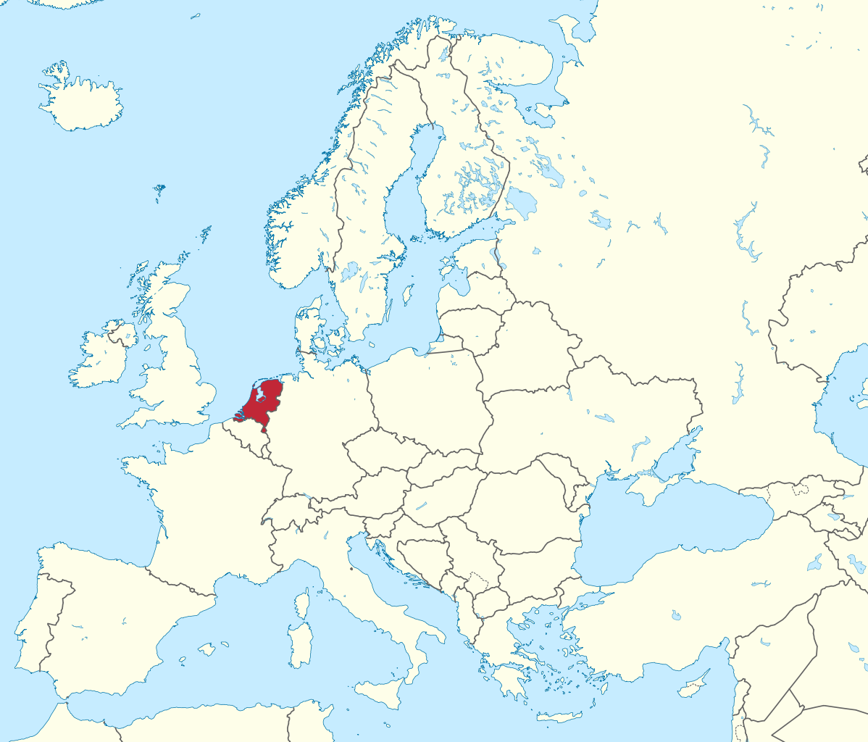
The Dutch

Slide 18
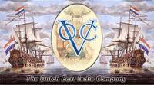
The Age of Exploration
The Dutch (Netherlands)
The people of this region declared their independence from Spain in 1581 and established the Dutch Republic
By 1600, the Dutch had the largest fleet of ships in the world- 20,000 vessels
The Dutch East India Company: Company that minted money, made treaties, and could raise an army.
Was richer more powerful than British East India Company
Eventually Dutch drove out the English and established dominance over East Indies

Slide 19
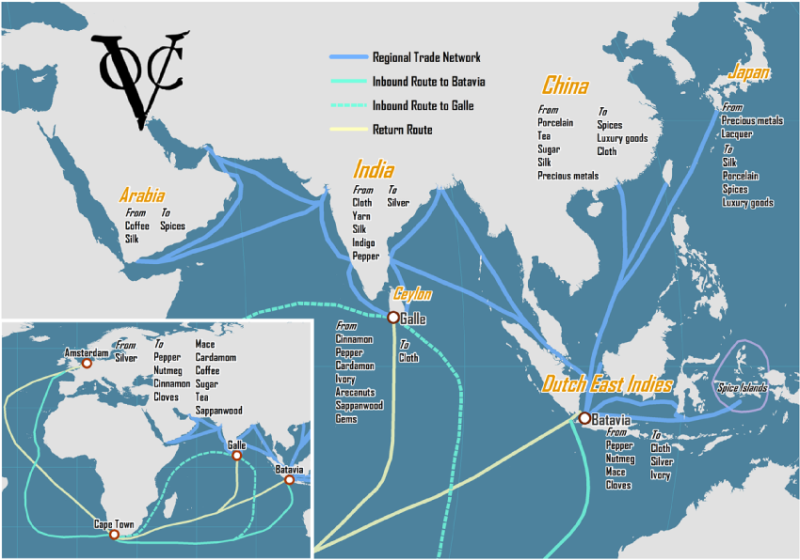

Slide 20
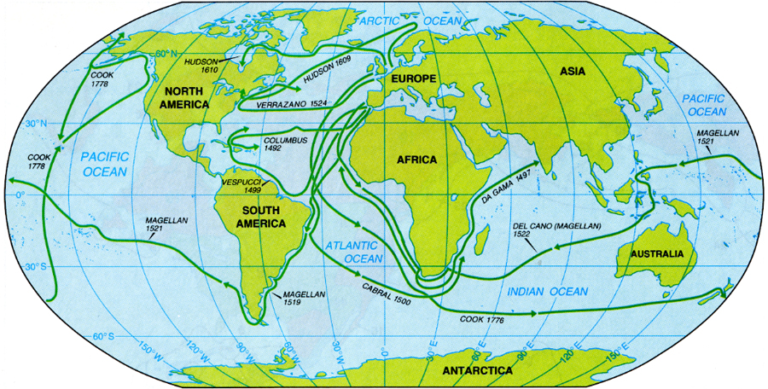
The Age of Exploration
Result: The Age of Exploration would begin a competitive and expensive pursuit that would lead the Europeans to India, the Far East, and eventually the New World.

Slide 21
Constructive Response Questions
What innovations allowed Europeans to travel farther?

