Slide 1
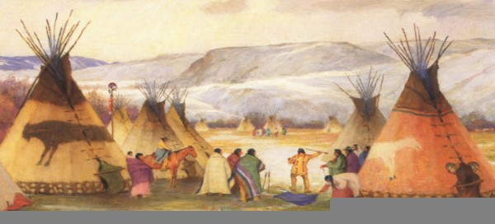
Reconstruction and Westward Expansion
Outcome: Conflict with Native Americans

Slide 2
Conflict with Native Americans
Setting the Stage: Native American Culture
Hundreds of separate, and diverse, sovereign tribal nations scattered across the United States for centuries
Most had social classes of some sort
Many were democratic in nature
Some of the tribes included Cherokee, Seminole, Dakota, Nez Perce, Apache, and Cheyenne.

Slide 3
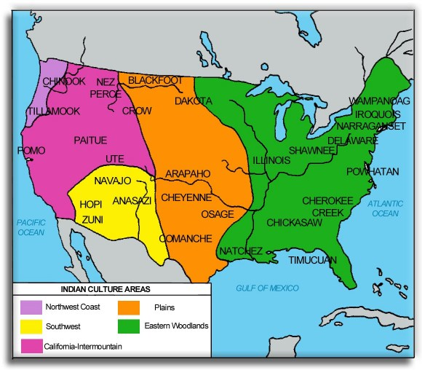

Slide 4
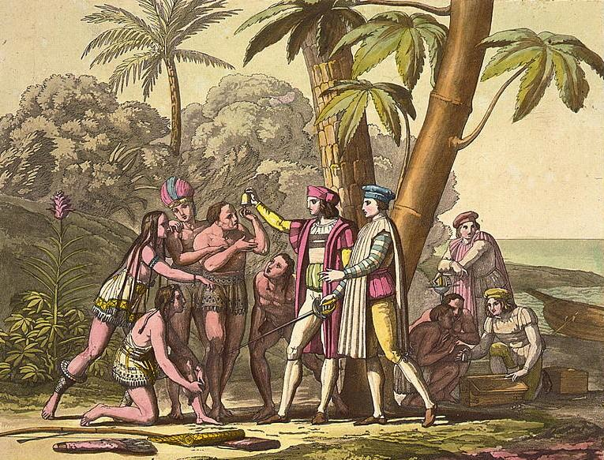
Columbus wasn’t the first one here…

Slide 5
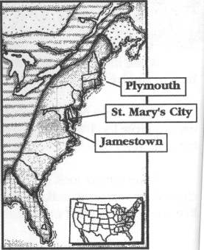
Conflict with Native Americans
Causes of Conflict
Conflict with Native-American tribes did not begin after the Civil War
Conflict with both Plymouth colonists and Jamestown colonists
Four thousand Cherokee (25% of population) died on the Trail of Tears
Native-Americans were involved in every major war up to this point

Slide 6
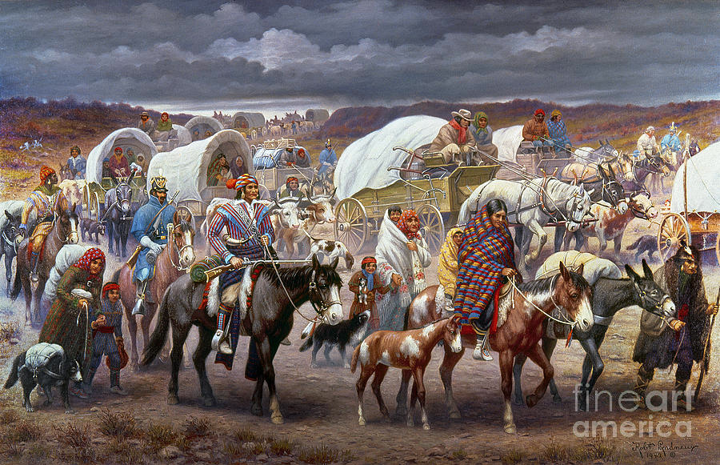
Trail of Tears

Slide 7
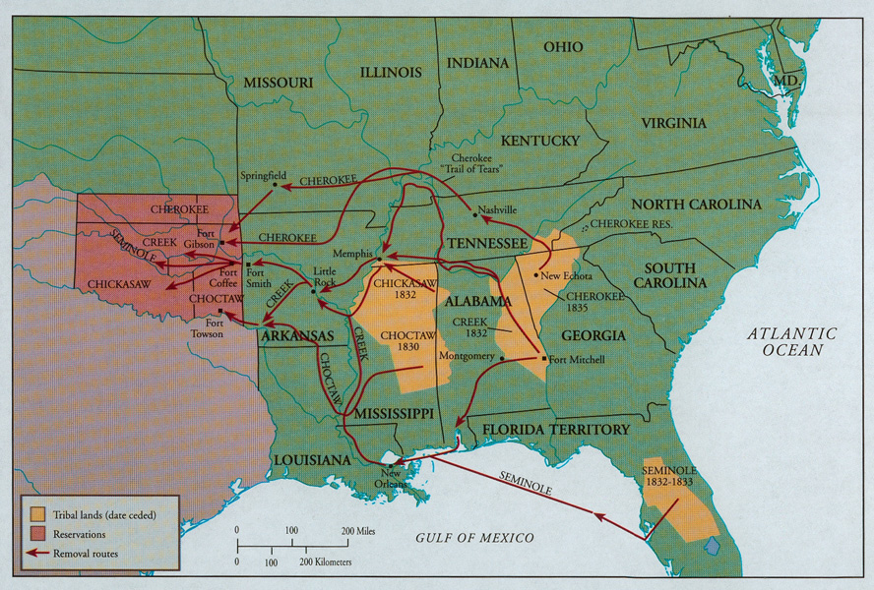
Indian Country

Slide 8
Conflict with Native Americans
Different Concepts of Land Ownership
Most tribal governments did not have a concept for ownership of land
Europeans settlers did not have a concept of anything else
Native-Americans believed they were sharing the land, European settlers believed they now owned it
Conflict would occur when both groups thought they could be on the same land

Slide 9
Conflict with Native Americans
Different Ideas of Government
Most tribal government leaders didn’t have authority to speak for all of their people
European settlers came from nations with kings and queens
Settlers would negotiate treaties with friendly tribal leaders, and then expect everyone in that tribe to follow it
Treaties with tribal governments were changed or thrown out as convenient to settlers
Conflict would then occur with members of tribes who didn’t want to follow the treaty

Slide 10
Conflict with Native Americans
Racism
Many American politicians and military leaders saw Native-Americans as inferior or as threats to be eliminated; were considered “savages”
Conflict would occur because many policymakers wanted conflict as an excuse to remove tribal governments

Slide 11
Conflict with Native Americans
Effects on Native Tribes
Tens of thousands of Native-Americans were taken from their lands and homes and moved to reservations
Thousands of Native-Americans are killed in military campaigns against tribes and bands who did not want to relocate
Buffalo are slaughtered in the tens of millions for food, for sport, and to deprive Native-Americans of food and supplies
US Government begins Assimilation Policy
Assimilation: a minority group’s adoption of the beliefs and way of life of the dominant culture

Slide 12
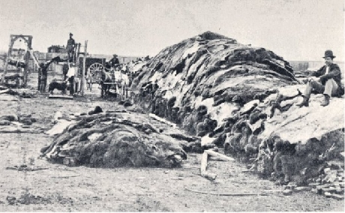
Slaughter of Buffalo

Slide 13
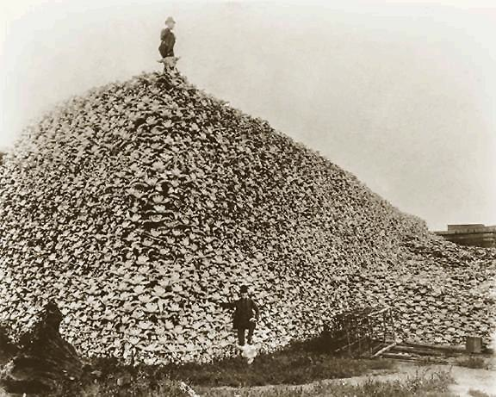
Slaughter of Buffalo

Slide 14
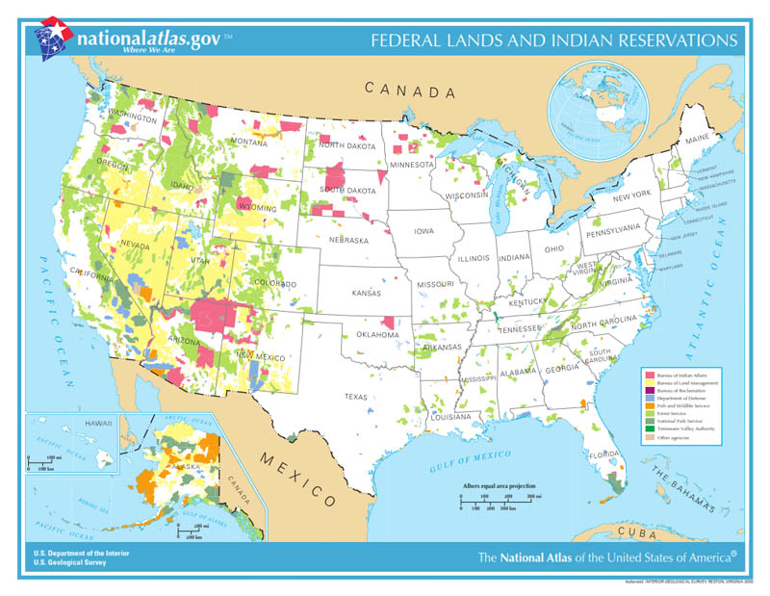
Reservations Today

Slide 15
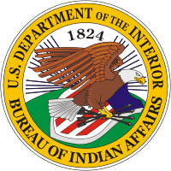
Conflict with Native Americans
Reservations
Reservations were set up on the most barren, least fertile land
They were crowded, unsanitary, and had little economic opportunity
Tribes were moved again when oil was struck or resources were found
They were regulated by the Bureau of Indian Affairs (BIA), which was often corrupt and rarely had Native-Americans’ best interests at heart

Slide 16
Conflict with Native Americans
Result: European/American culture clashed with Native American culture, which resulted in the mistreatment of thousands of Native Americans. Even today, many Native Americans still face economic and social hardships brought on by westward expansion.

