Slide 1
Classical Greece
Vocab

Slide 2
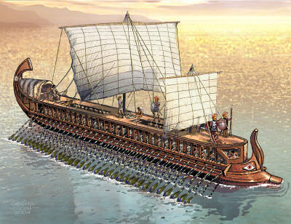
City-state: A city that functions much like an independent country
Tyrant: powerful individuals who gained control of a city-state’s government by appealing to the poor for support
Trireme: strong wooden ships built with battering ram in front

Slide 3
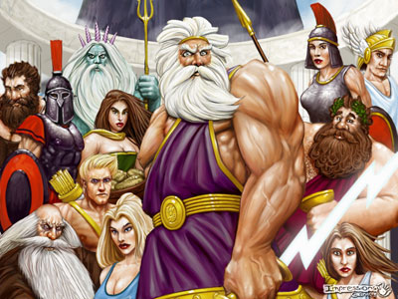
Myth: a traditional story about gods, ancestors, or heroes, told to explain the natural world or the customs and beliefs of a society
Iliad: Poem written by Homer telling the tale of how the Greeks and Trojans battled for 10 years after Paris stole Helen away from Menalaus
Odyssey: Poem written by Homer telling the story of Odysseus’s return from the Trojan Wars to his home in Ithaca

Slide 4
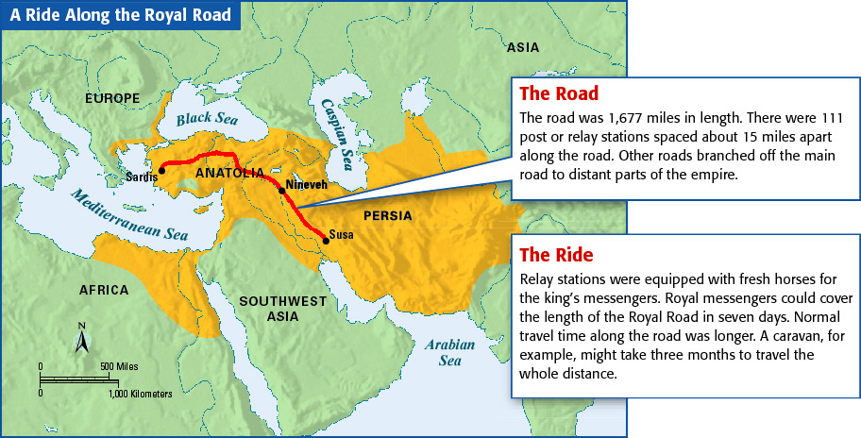
Royal Road: a road in the Persian Empire, stretching 1,600 miles from Susa in Persia to Sardis in Antatolia

Slide 5
Phalanx: a military formation where soldiers fought shoulder to shoulder and shield to shield for protection
Thermopylae: Mountain pass where 300 Spartan soldiers held off thousands of Persian soldiers during the Persian Wars. Also called The Hot Gates.
Marathon: marshy plain where the Athenians successfully defeated an invading Persian force during the Persian Wars. Also origin of Marathon run due to messenger Pheidippides.
Hoplite: Name of the soldiers used in the battle of Marathon

Slide 6
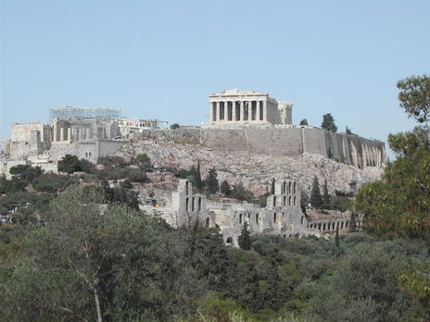
Acropolis: fortified hilltop
Monarchy: a government ruled by a king or queen
Oligarchy: a government in which power is in the hands of a few people – especially one in which rule is based on wealth
Democracy: a government controlled by its citizens
Aristocracy: a government in which power is in the hands of a hereditary ruling class or nobility

Slide 7
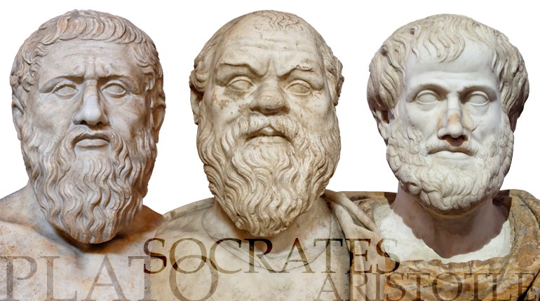
Philosopher: a thinker who uses logic and reason to investigate the nature of the universe, human society, and morality; also known as lover of wisdom

Slide 8
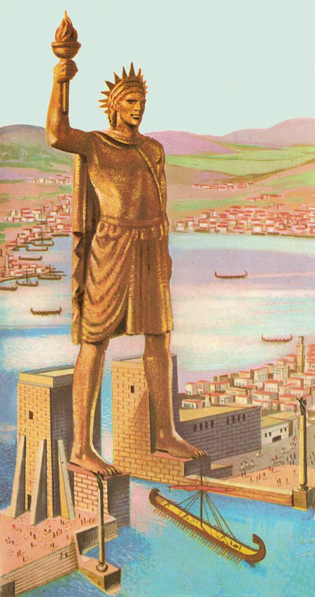
Hellenism: blending of Greek, Macedonian, Persian, Egyptian, and Indian cultures due to Alexander’s conquests
Colossus of Rhodes: an enormous bronze, Hellenistic statue that formerly stood near the harbor of Rhodes. At 100 ft tall it was one of the Seven Wonders of the Ancient World

