Slide 1
The Persian Wars

Slide 2
The Battle of Thermopylae

Slide 3
Constructive Response Questions
#4: Who were the Persians and how did they disrupt life for the people of Greece?
#5 In a short paragraph, describe what happened and the significance of the battle of Marathon or Thermopylae.

Slide 4
The Battle of Thermopylae
Who?
Xerxes (Son of Darius) & The Persians
King Leonidas & 300 Spartans
Where?
A mountain pass called Thermopylae or the Hot Gates

Slide 5
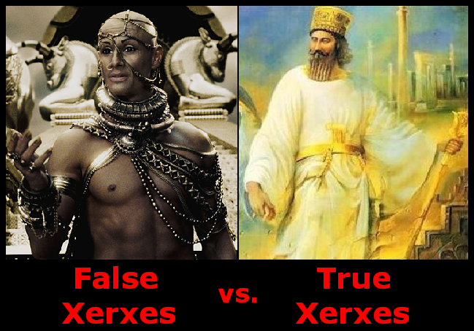

Slide 6
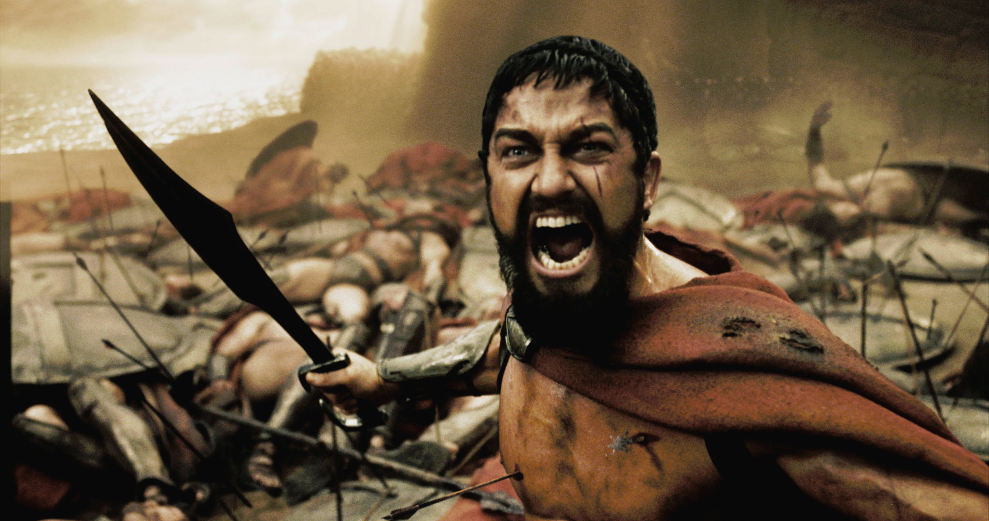
King Leonidas in 300

Slide 7
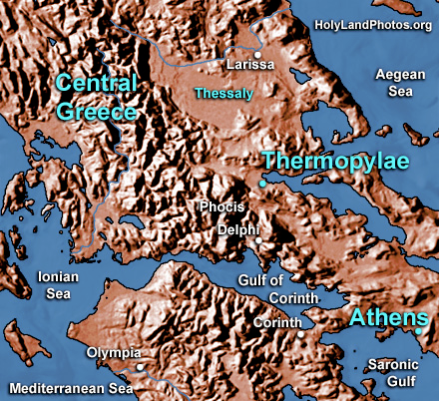
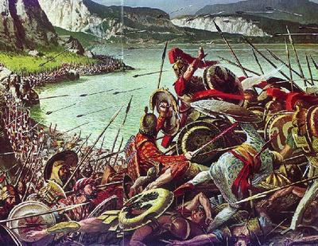
The Battle of Thermopylae
When?
480 B.C.

Slide 8
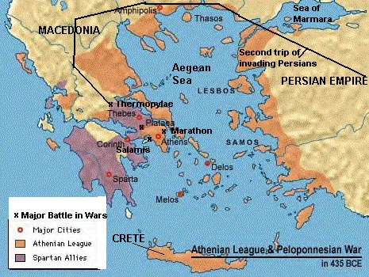
The Battle of Thermopylae
Why?
Xerxes was eager to defeat Greece after their loss at Marathon ten years earlier.
When?
480 B.C.

Slide 9
The Battle of Thermopylae
What happened?
10,000 Greeks led by Leonidas met the Persians at Thermopylae
The Greeks led the Persians into the narrow pass.
A Greek traitor showed the Persians an alternate route.
Leonidas and 300 Spartans stayed to defend the pass.
All of the Spartans and Leonidas were killed.

Slide 10
The Battle of Thermopylae
Who Won?
The Persians…
Xerxes burned Athens to the ground
But…
The Spartans had held on long enough to allow many others to get to safety.

Slide 11
Constructive Response Questions
#4: Who were the Persians and how did they disrupt life for the people of Greece?
#5 In a short paragraph, describe what happened and the significance of the battle of Marathon or Thermopylae.

