Slide 1
Age of Exploration
Vocab

Slide 2
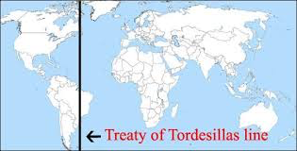
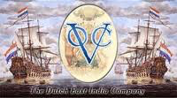
Treaty of Tordesilla: 1494 agreement between Portugal and Spain that divided their New World land claims.
Dutch East India Company: Company established to direct trade in Asia. Could mint money, make treaties, and even raise an army.

Slide 3
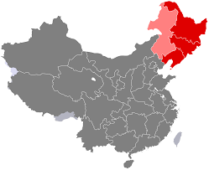
Ming Dynasty: Chinese dynasty that ruled from 1368-1644
Manchus: Invaders from north of China who invaded and caused the Ming Dynasty to collapse.
Qing Dynasty: Dynasty begun by the Manchus. Ruled China for more than 260 years.

Slide 4
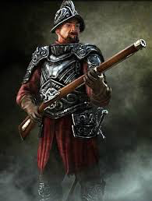
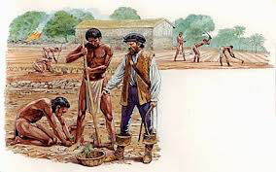
Colony: lands controlled by another nation.
Conquistador: Spanish conqueror
Mestizo: Mixed Spanish and Native American population.
Encomienda: Forced Native American labor by the Spanish.

Slide 5
Pilgrims: English colonizers who established English colony of Plymouth in 1620 after leaving England for being persecuted for their beliefs.
Puritans: English group seeking religious freedom from England’s Anglican church. Sought to build model Christian community at Massachusetts Bay colony.

Slide 6
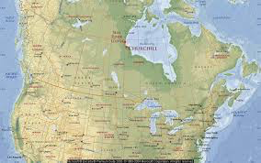
New Netherlands: Dutch colony established in North America. Also found Hudson Bay & Hudson Straight
Jamestown: First permanent settlement established by the British in 1607. Named after King James.
New France: French colony established for fur trading. Also founded Quebec.

Slide 7
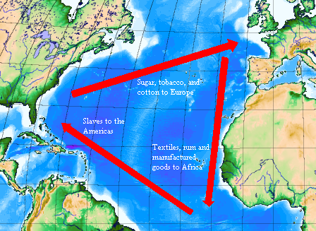
Atlantic Slave Trade: The buying and selling of Africans for work in the Americas.
Triangle Trade: Trade network by which African slaves were captured and traded/sold for goods in Africa, the Americas, and Europe.
Middle Passage: The voyage that brought captured Africans to the Americas.

Slide 8
Columbian Exchange: The global transfer of foods, plants, and animals during the colonization of the Americas.
Capitalism: Economic system based on private ownership and the investment of resources, such as money, for profit.
Mercantilism: Theory that held that a company’s power depended on its wealth.
Joint-Stock Company: Worked like a corporation with investors buying shares of stock of a company.

